Slide 1



⚡ by
GlassBox
Advanced Merchant Management
OCT 2023 V2.3

Slide 2








Maintain Complete Control
Increase Your Business Value
Overview
Being a payfac allows you complete control over the distribution of funds to your users
Owning the merchant and card data can significantly increase the value of your business
Why be a PayFac?
Recurring Revenue Stream
Increase Your Profit Margins
Custom Fee Schedule
Reduce Business Risks
Introduce a new recurring revenue stream for your business by monetising payments happening in your platform
Being a payfac can significantly increase your profit margin when compared to partnering with payment platforms such as Stripe and PayPal
The ability to implement custom fee schedules without having to negotiate with your payments platform partner
Reducing the risk of your payments platform partner changing fees or terms that may negatively impact your business

Slide 3




Pinch Payfacs
Our Merchant Management System
We’ve solved EVERY payfac tech challenge in one service.
All Levels of Hierarchy
Acquirer Assistance
6 Years and 1,500 Merchants
Key features include a Merchant Management System (MMS), onboarding, fraud detection and front end systems for all levels of hierarchy from administrator to card holder
We can assist in acquirer introduction and in policy and procedure requirements. Pinch operates a PayFac ourselves so we’re well placed to navigate the hurdles of becoming one
A culmination of the systems and technology developed by Pinch to service it’s merchants over the past 6 years. Pinch uses the system on a day to day basis to manage it’s 1500 merchant accounts

Slide 4














Pinch Payfacs
The Pinch
Support Stack
Payment Gateways
Risk & Compliance
Credit Card Acquirers
Additional Payment Rails

Slide 5

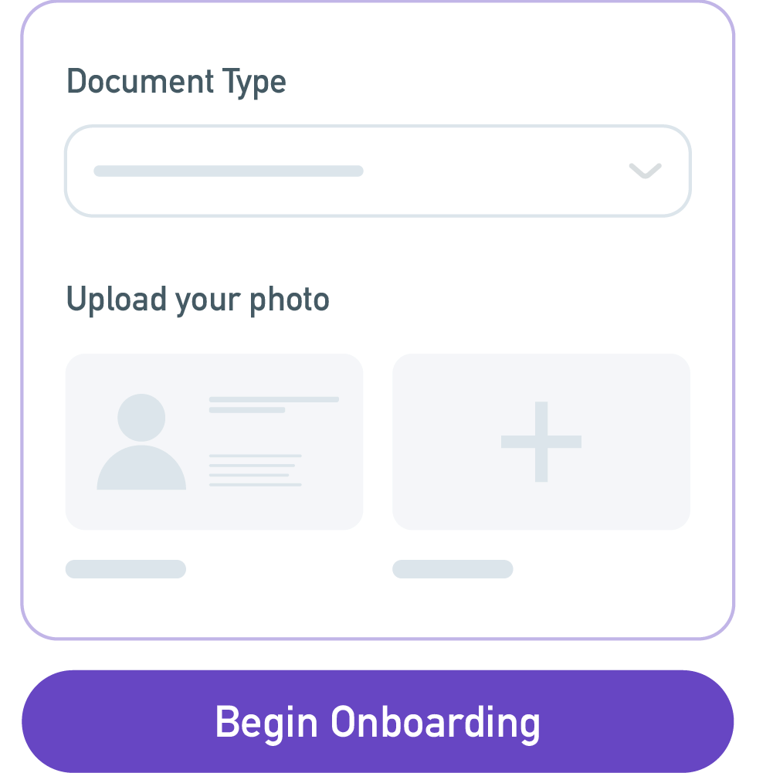
Pinch Payfacs
Experience
Integrated Onboarding and KYC Automation
We Securely Identify Every Merchant
Email and phone verification
Secure documentation upload for identity documents
Interactive biometric identification test
Bank account verification technology
Prepayment risk profiling
Real time regulatory checks and UBO reporting
AML / PEP / CTF and sanction checks
Credit checks
Compliant with major acquirers worldwide
The onboarding portal is designed to be a self service as possible and will provide updates both internally and notifications to any 3rd party software such as Salesforce or HubSpot.

Slide 6






Merchant Communications
Complete Data Visibility
Merchant Management System
Reduce friction when onboarding merchants by using the event driven notification system to automate communications
View transaction history and behaviour including data on chargebacks, refunds and disputes and profitability of a merchant
MMS Overview
Centralised Control
Role Based Security
Connections and Integrations
Reduce Business Risks
Manage the relationship between you and your merchants. A place to approve merchants to process transactions, transfer funds and set payment limits
Protect sensitive data with role based permissions. There is even a login for your acquirer to increase transparency
Connect your MMS with popular CRM’s such as Salesforce and HubSpot. Event driven meaning any 3rd party system can integrate easily
Settlement summaries, transaction monitoring, real time fraud, prepayment profiling and MATCH checks come included in the platform

Slide 7


Pinch Payfacs
Professional
Fee Management
Manage merchant fees for cards, BPAY and direct entry transactions
Easily configure custom fee schedules for each merchant
Offer blended rates pricing based on the card scheme type, funding source and origin
Calculated transaction fees shown for each payment attempt and the decisions made
Ability to surcharge all transaction fees onto the card holder
Ability to apply temporary fee structures to assist in promotions or special offers
The platform calculates your total cost of each transaction, including your profit margin after standard costs such as interchange, scheme and merchant service fees.

Slide 8




Pinch Payfacs
Our Merchant Management System
Risk Mitigation and Fraud Detection
Advanced Protection
Strategic
Partnerships
End-to-end risk Management
Gain protection from:
Money laundering through your platform
Financial loss
Chargebacks and disputes
Prepayment risk
Settlement risk
Pinch partners with FrankieOne, a fintech company based in Australia who aggregate KYC / AML and credit checks. It is a market leading platform that provides biometric identity tests for individuals and regulatory tests for businesses
Each transaction is protected in real time via Kount, an Equifax Company. Rulesets can be created and customised to suit your risk appetite. Also compatible with Visa Decision Manager.

Slide 9




Pinch Payfacs
The Pinch Solution
Ongoing support and managed service
Primary and Team Based Support
Education and Guidance
We’ve Always Got Your Back
An account manager will be assigned to you with direct phone and email access. Backed by technical support from the team to assist with ongoing help, troubleshooting and education
Using our experience of being a payfac, we will provide guides on getting started with concepts such as onboarding, recurring payments and fraud profiles. We will work with your acquirer to ensure best practices are adhered to.
Regular communication with you post live and invitations to suggest new features. As we provide the MMS as a SaaS offering, the product will continuously evolve based on customer feedback

Slide 10
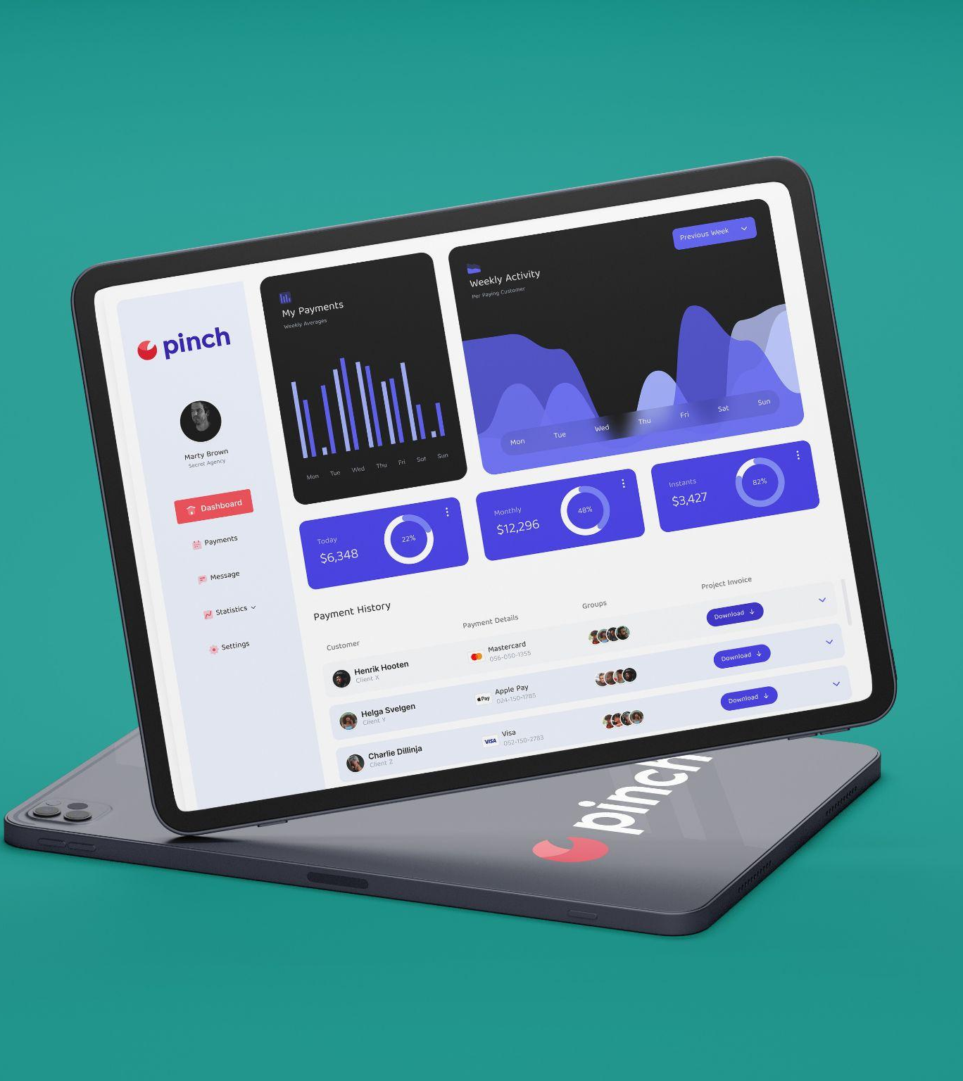
Pinch Payfacs
Glassbox
How did we get here?
In 2017, Pinch Payments entered the payments ecosystem as a customer-focused alternative to established online payment options. By focusing on payment automation, and through a partnerships oriented growth plan, we have helped in excess of 1500 Australian businesses improve their cash flow.
Along the way we realised another opportunity. Setting up a payfac is an expensive and time consuming exercise with so much regulatory requirement that it discourages businesses from implementing the necessary systems to de-risk themselves and operate at the standards set by their acquiring partners.
Introducing our solution, GlassBox, Australia’s first payfac as a service platform. Developed by the same team behind Pinch Payments, GlassBox is the platform we wish we had. GlassBox will provide the next generation of Australian payment facilitators with a more guided path to establishment, streamline day to day operations and provide acquiring partners with a solution they can offer their own customers that helps them meet the necessary regulatory requirements to trade.
Notes:
Nerisa suggested edits:
In 2017 Pinch Payments entered the payments ecosystem as a customer-focused alternative to established online payment options. By focusing on payment automation, and through a partnerships oriented growth plan, we have helped in excess of 1500 Australian businesses improve their cash flow.
As our business has grown, we have come to acknowledge the difficulty, expense, time, and resources needed to set up the necessary payment processes and realised the benefits we can not only provide to SMEs but more broadly to interested payments facilitators (payfacs). From acquiring platforms to end-to-end payments insight, Pinch now provides its same trusted service to businesses wishing to taking payments in their own right.
Introducing, Glassbox – Pinch for Payfacs. Glassbox will provide the next generation of Australian payfacs with a more guided path to establishment, streamlined day-to-day operations, and a packaged solution to help payfacs meet the necessary regulatory requirements to go from merchant on record to fully-fledged payfac. (edited)

Slide 11

APR 2023 V2.1
⚡ by
Thank You
Paul Allen
0477 415 698
paul@getpinch.com.au

